Slide 1



TRADER TRACK
SMART FINANCE TRACKING FOR SMALL TRADERS.
01

Slide 2


Problem Statement
Many small traders in Kenya and across Africa operate without taking record of their profits and expenses that seriously and without this visibility they would:
Cannot tell if they are making a profit or loss.
Struggle to access financial services and loans.
Operate inefficiently and face higher financial risks.
10

Slide 3

TRADERTRACK PROVIDES
1. Voice-based transaction entry.
2. Photo based receipt recognition.
3. Automatic categorization of income and expenses.
4. Real time profits and real time cash flow insights.
5. Simple, mobile friendly User Interface.
06

Slide 4
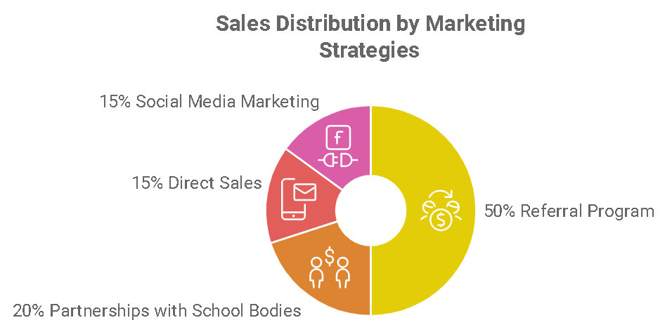
Product
TraderTrack is a mobile-first web application that:
Let’s users record income and expenses via voice, photo or manual
Shows real time dashboards with total incomes, expenses and profits
Stores data securely in the cloud using Supabase
Enables small traders to build financial records for funding and credit
04

Slide 5



Target Market
2 out 5
Elaborate on working with digital record keeping.
82%
Comprises of informal sector
7.4 million
Micro enterprises work without digital record keeping.
14

Slide 6
Market Size
Estimated Total Addressable Market (TAM):
7.4M informal traders
Each could generate KES 1,200 per year in subscriptions, ads, or service fees
Pie Chart:
40%: Food and produce vendors
25%: Small kiosks & retailers
20%: Mobile money / agent shops
10%: Transport (boda-boda, delivery)
5%: Others

Slide 7
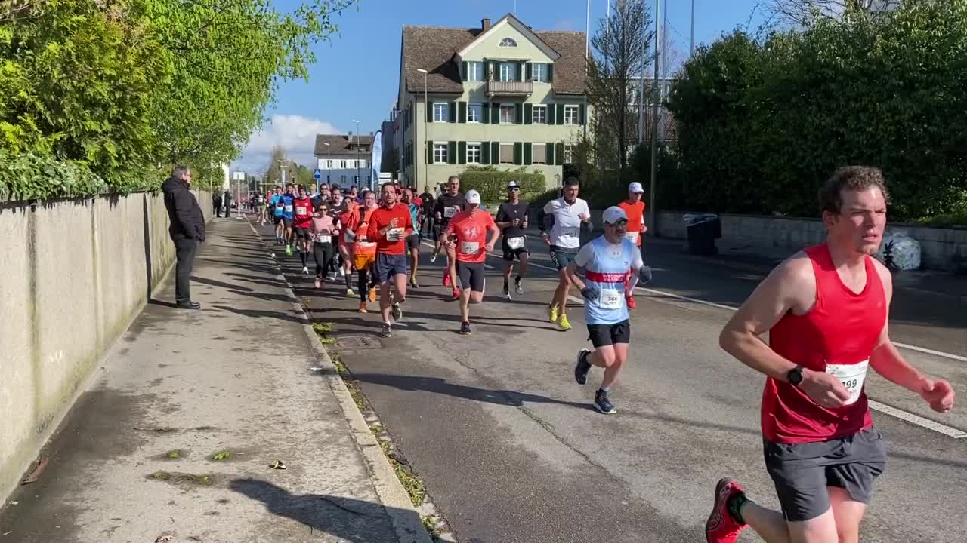
Competitors
Tally – Focuses on formal SMEs, no voice or photo input allowed
M-pesa for Business – Primarily payment processing
Quick Books – too complex and costly for small traders
TraderTrack difference:
Voice / Photo input for fast data capture
Built for the informal sector
Offline – first and mobile optimized
23

Slide 8

Competitive Advantage
Voice + Photo input for instant updates
Offline usability (PWA-ready)
Designed for low-literacy and low-tech users
Simple UI, tailored to local trader workflows
Rapid deployment, scalable on Supabase

Slide 9
Project Traction
Tasks
Month 1
Month 2
Month 3
Month 4
Month 5
Research
Build MVP
Modular testing of the MVP
Deployment of MVP
User Acceptance testing
Full roll out of app
Debug and updates
Future works
23

Slide 10

Business Model
Freemium model (basic use free)
Premium features:
Automated backup and export
Business reports for loan applications
Profit Margins:
Projected: 70% gross margin
Monthly: KES 100 subscription/user
23

Slide 11
Customer Acquisition
Community-based outreach in markets and stalls
Partnering with SACCOs and mobile lending platforms
WhatsApp & SMS onboarding flows
Referral incentives for traders

Slide 12
Social Impact
Empowers informal workers with financial visibility
Enables access to credit for growth
Promotes savings and business planning
Boosts economic stability for families
Encourages digital adoption in underserved sectors

Slide 13
Our Ask
We are seeking KES 2,000,000 (approx. $15,000) to:
Develop advanced AI voice/photo recognition (KES 600,000)
Hire 2 developers (KES 800,000)
Conduct pilot in 3 counties (KES 400,000)
Marketing & customer onboarding (KES 200,000)

Slide 14

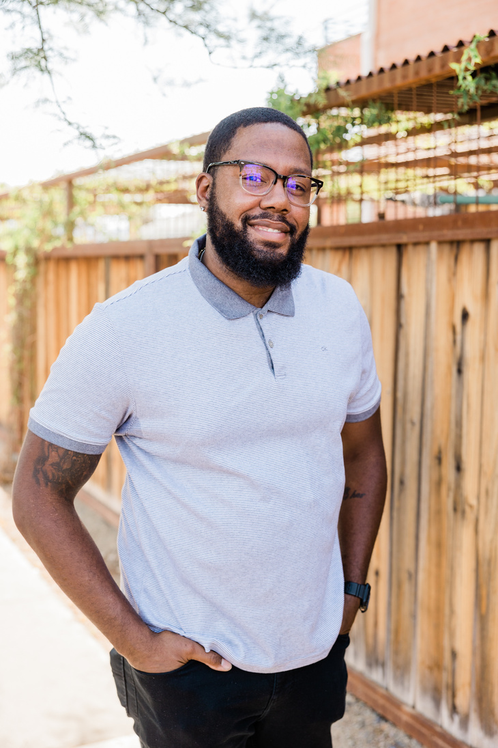


Team Members
Jane Mwende
Kevin Kimani
Faith Kamau
Samuel Lot
Project Lead and Product Designer
Full Stack Developer
Community Engagement
Research

Slide 15



Thank you!
Email: team@tradertrack.africa
Website: www.tradertrack.africa
Twitter: @TraderTrackKE
WhatsApp: +254 719524276
LinkedIn: TraderTrack Kenya
17

